Slide 1
ELEC3542 Project My Dream House
By Small Potato Inc.
Goodest product in my dream (2018)
CEO: Tommy Potato

Slide 2
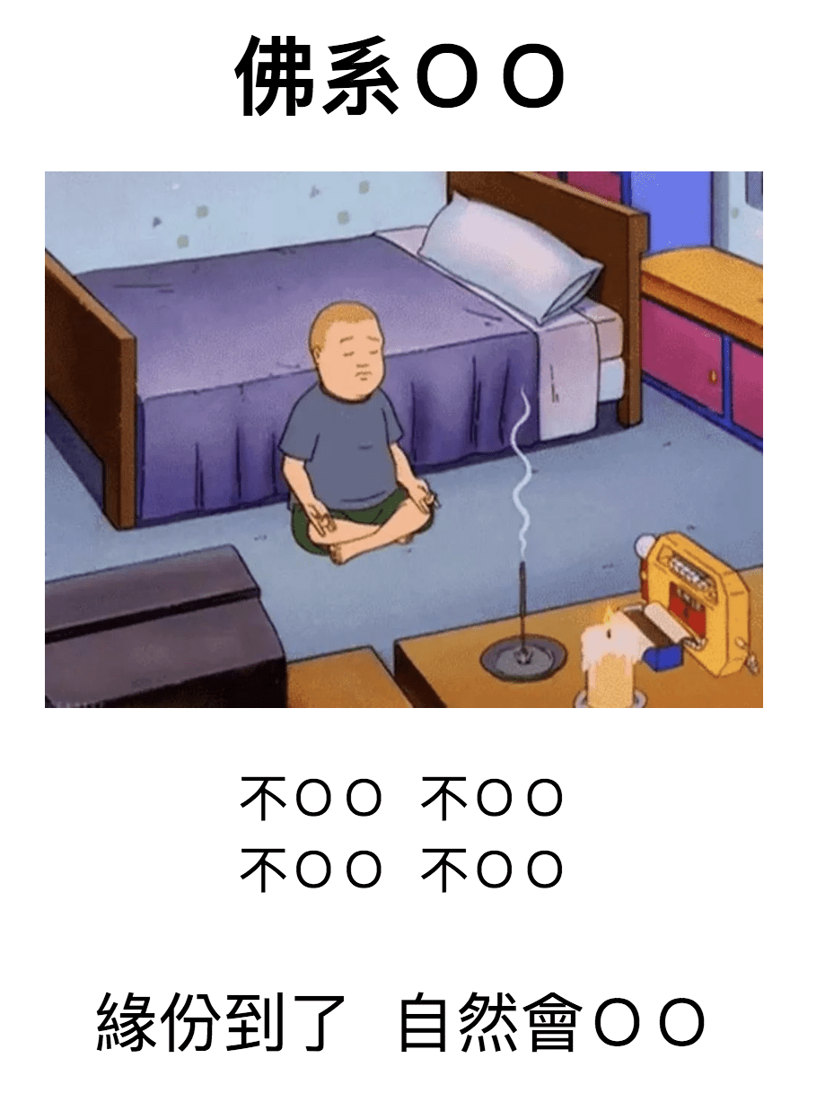
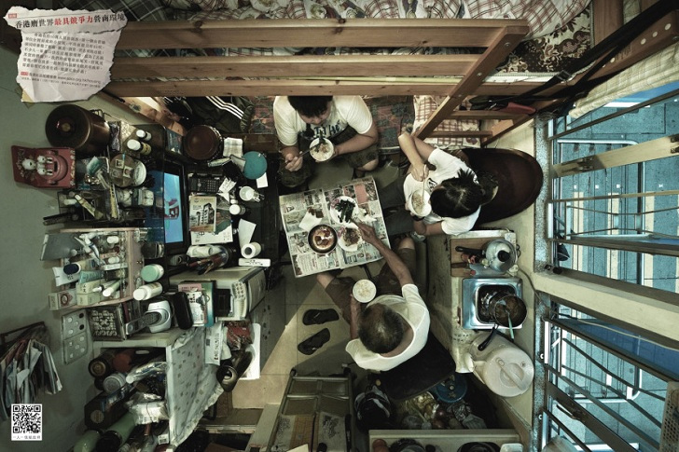
Problems
House are too small
Human are ‘lazy’ (at least I am)

Slide 3
Lazy or Convenient?
Lazy can be a motivation → convenient
Make people lazier (more convenient)

Slide 4
My Dream House
Temperature Moderator
Smart TV Set

Slide 5
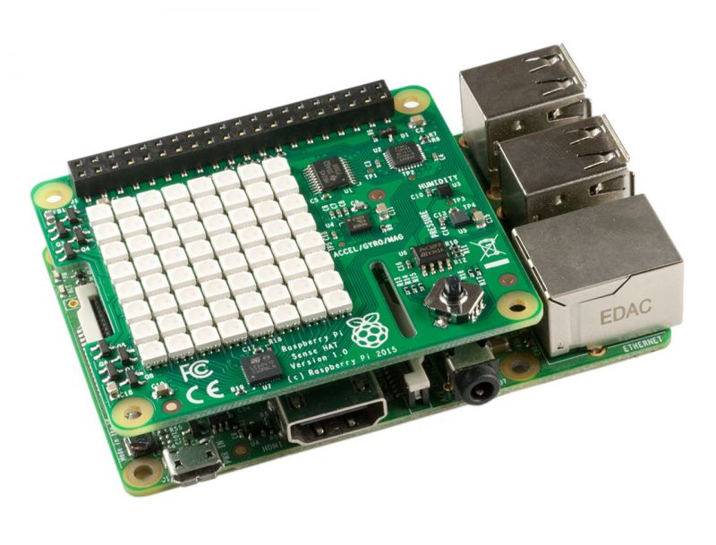
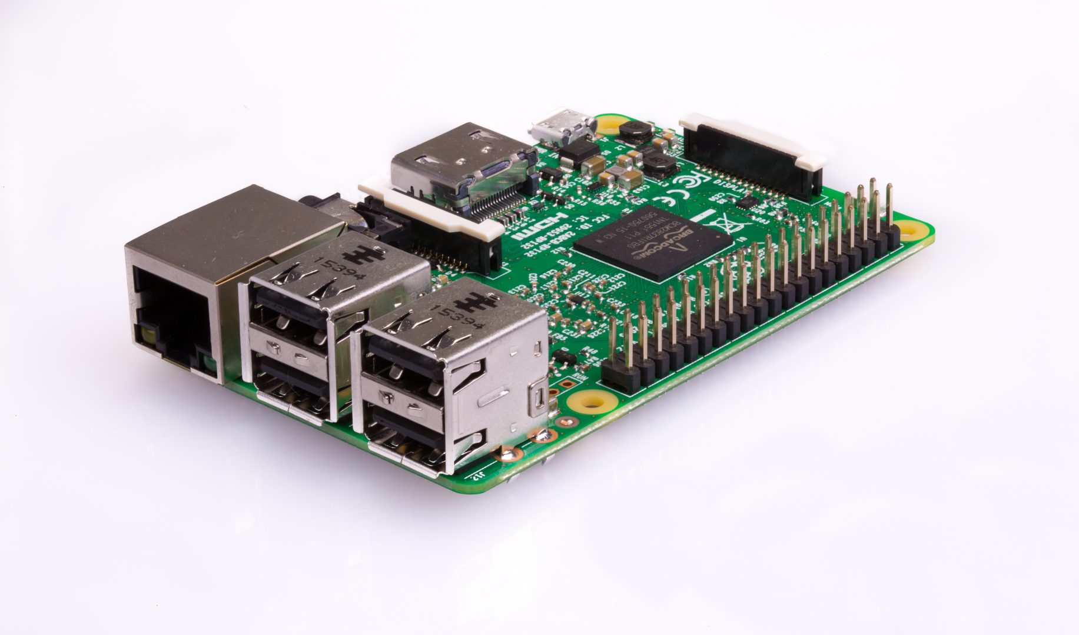
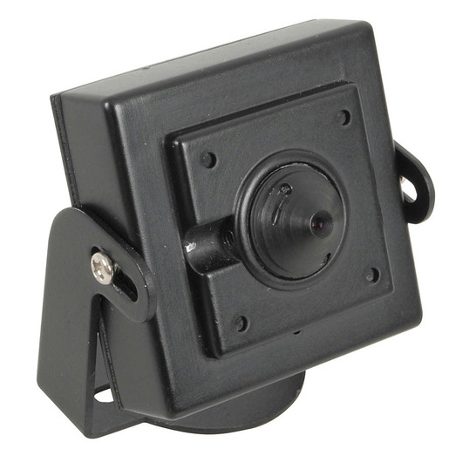
Equipment
Low cost
Camera
SenseHat
4 RPi3 s
One as AP (Label as A)

Slide 6
Temperature Moderator
Records the temperature of indoor and outdoor → fan/air con
Use of SenseHat
D

Slide 7
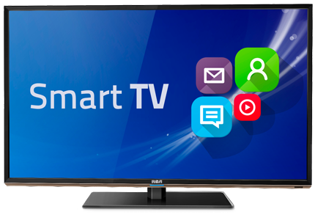


Smart TV set

Slide 8

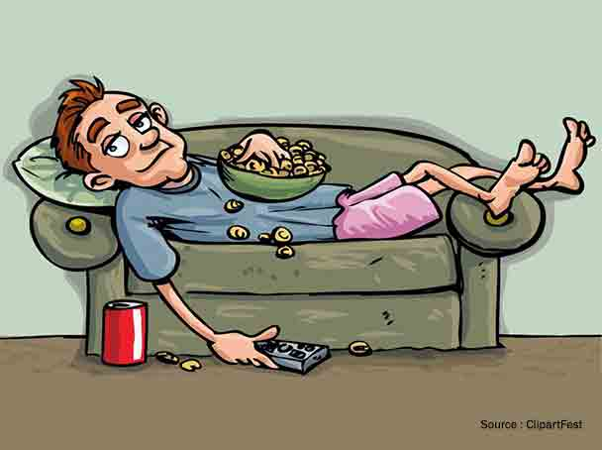
Smart TV set
Tommy Detected!!!!! He loves to watch ABC Show
Take Photo
Send Photo
B

Slide 9
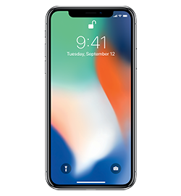
Smart TV set
C
Give Command
Command (Siri)
B

Slide 10
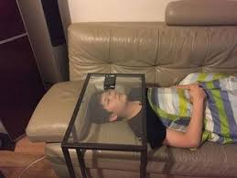

Solution to problem
‘Lazy’:
Make people more convenient
Customize
Space is small:
Can’t purchase large device or several devices
Multifunctional (All-in-one)

Slide 11
Suitable for……………
Lazy people
Elderly
Disabled

Slide 12
Feasibility & Scalability
Facial recognition is quite accurate nowadays
Some algo accuracy of 99.38% on the Labeled Faces in the Wild benchmark
Required device is few (even with one RPi3 and camera)
Low cost
Can be scaled up in terms of functions and size
Can include smart storage, lighting etc
Can be apply into almost every modern home
Smart TV is not a must

Slide 13
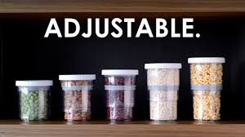
Future plan
Smart Storage
Smart Lighting
Smart Security
Software application
More functions

Slide 14
Find me if you are interested Thank you !!!!

